Slide 1
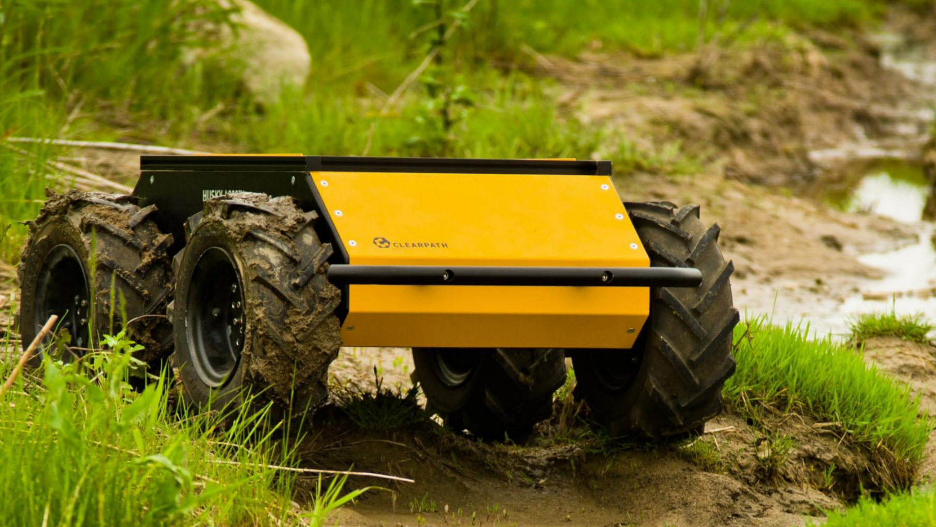
Husky UGV

Slide 2
Structure
Design & Functionality
Actuators & Locomotion
Data Collection
Navigation & Controllers
Data Transmission
Power System Management

Slide 3

Robot Design & Functionality

Slide 4
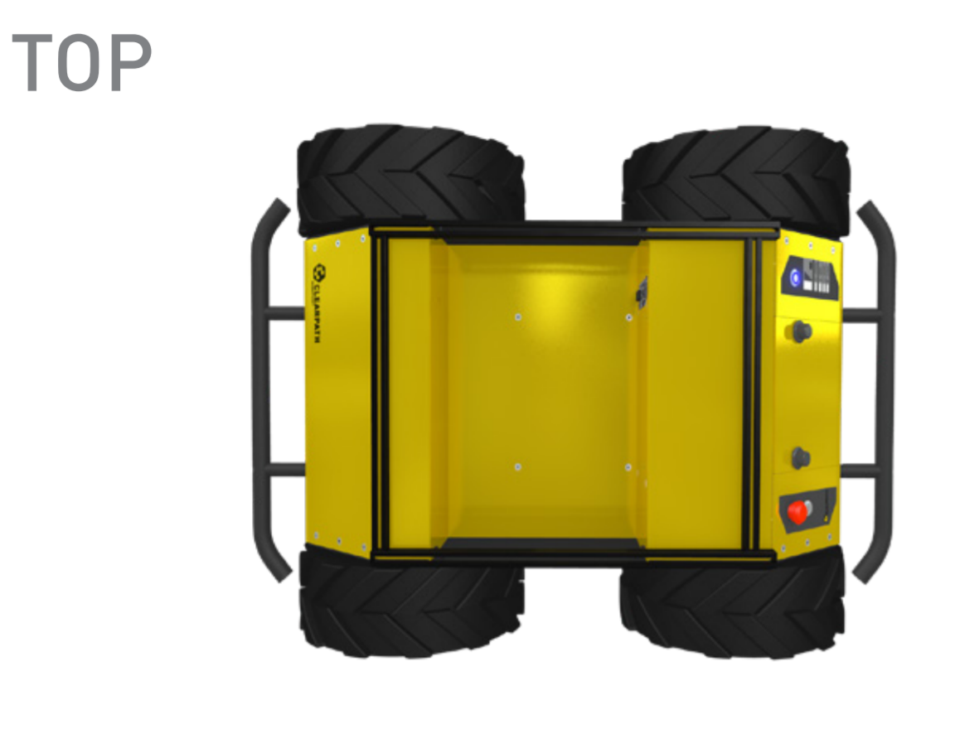
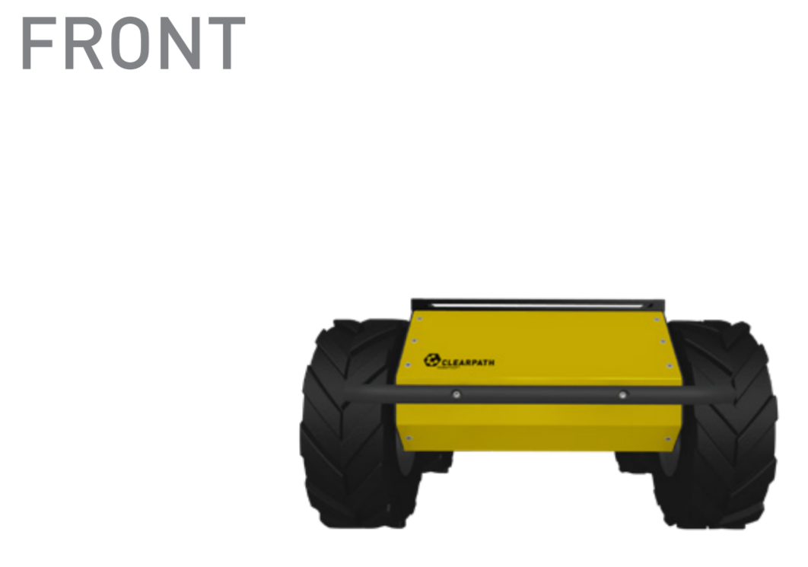
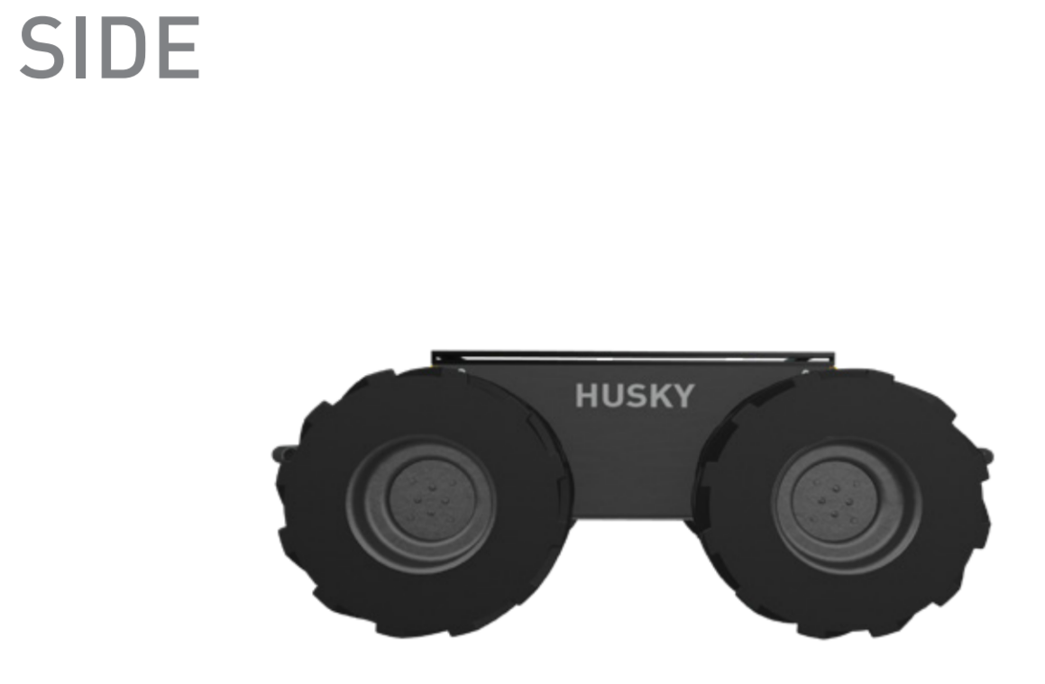
Design

Slide 5
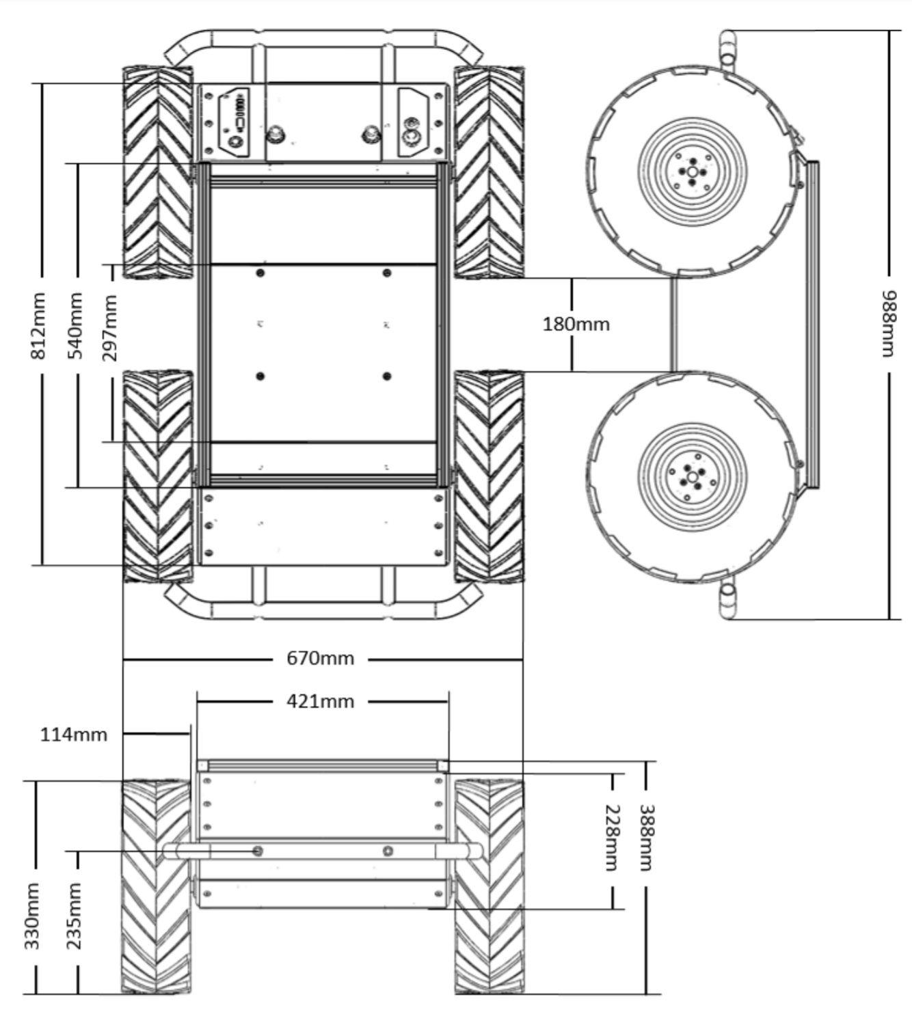
Dimensions

Slide 6
Functionality
Multi Robot System
-scalable and open architecture
Perception And Navigation
--tunable vehicle control parameter, high resolution wheel odometry and full power system diagnostic
Tele Operation
-Husky can be tele-operated by plug in wireless joystick

Slide 7

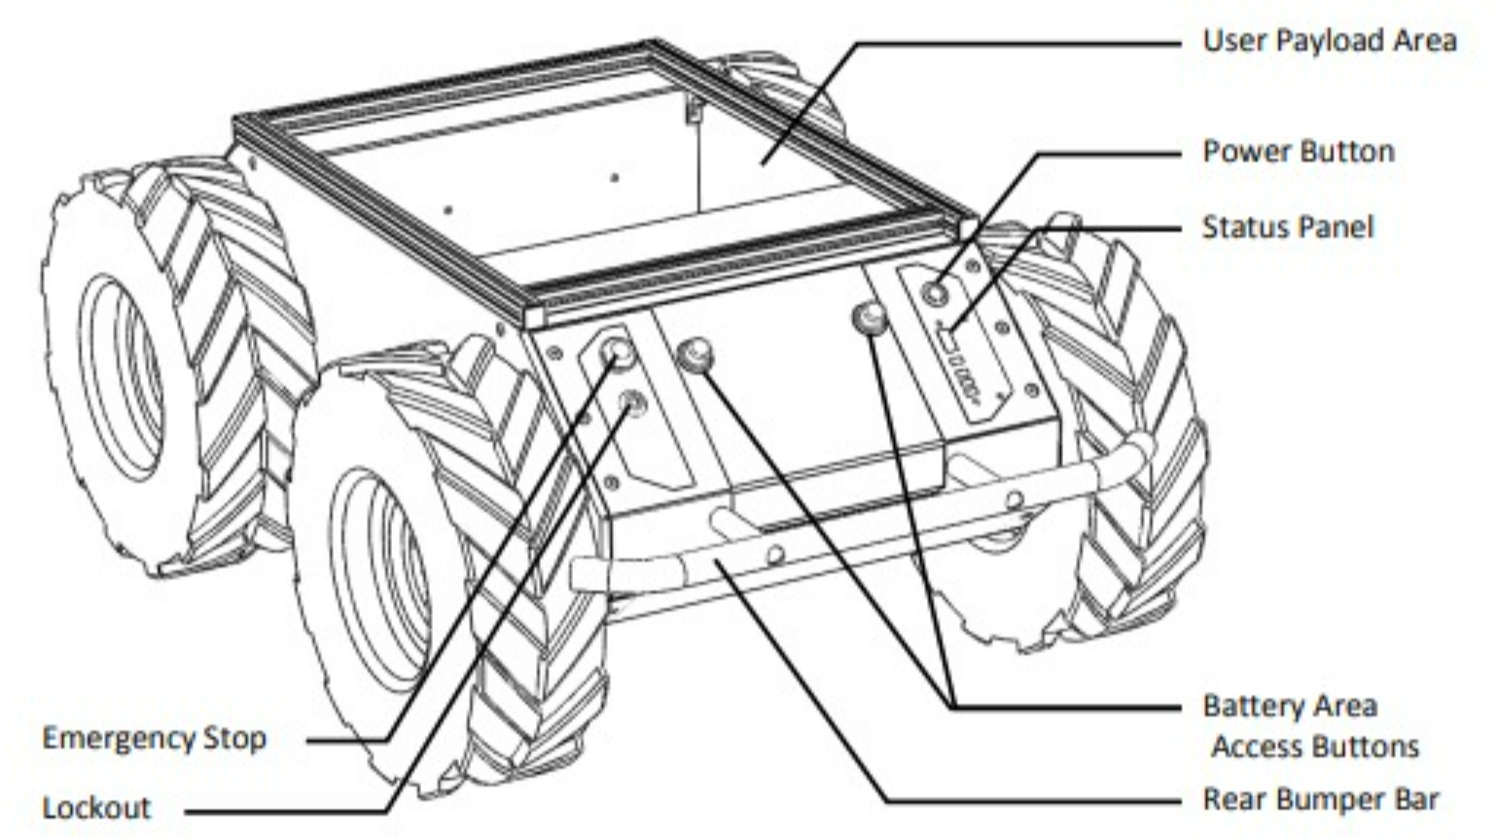
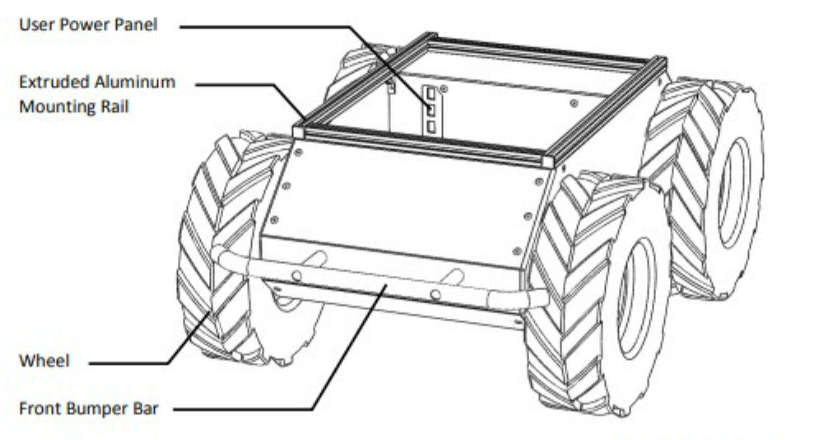
Functionality

Slide 8
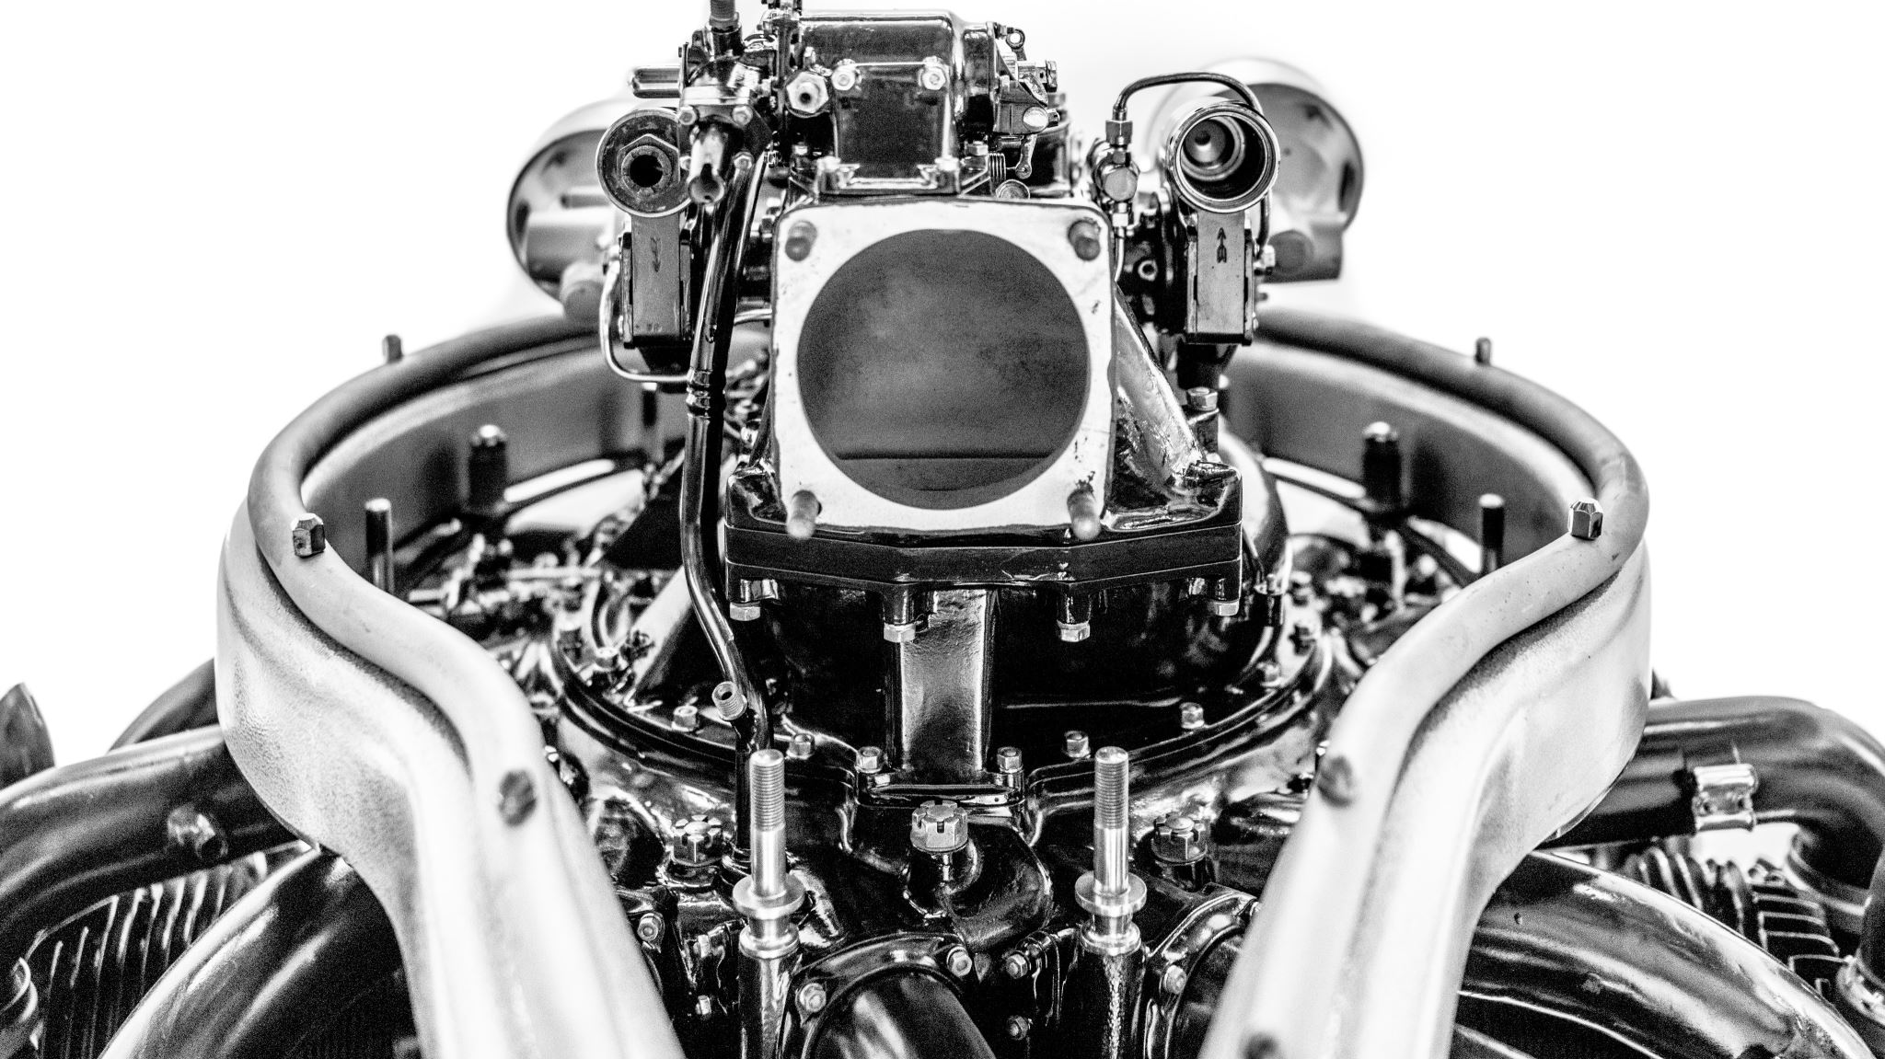
Actuators & Locomotion

Slide 9
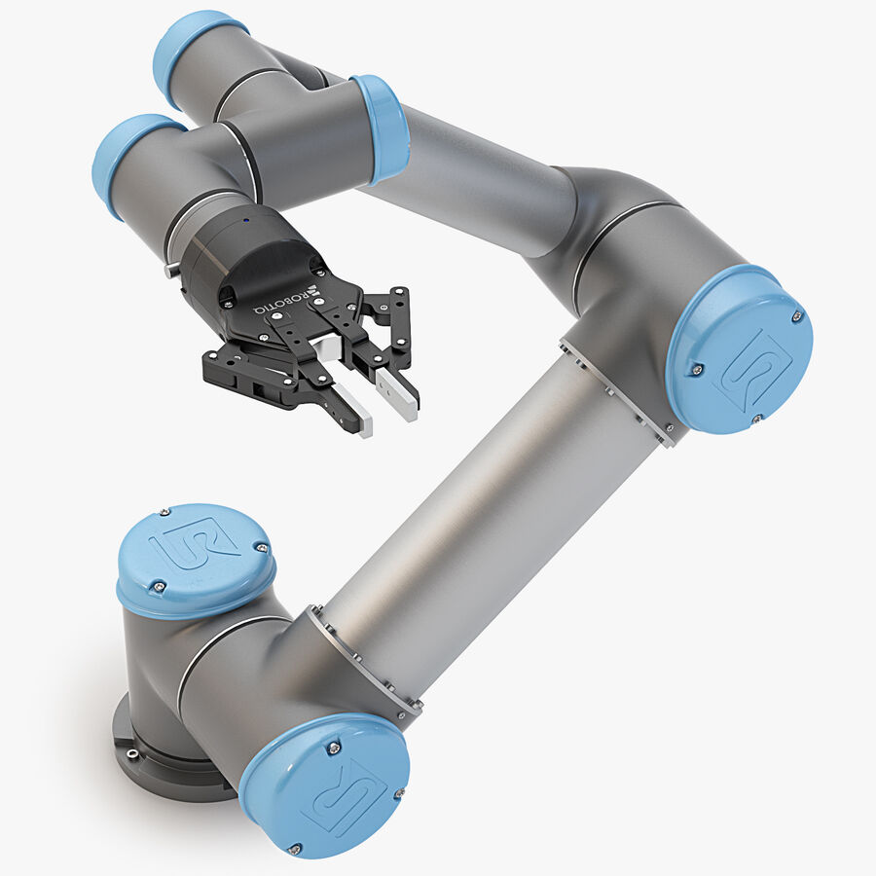
Ur5 Collaborative robot arm

Slide 10
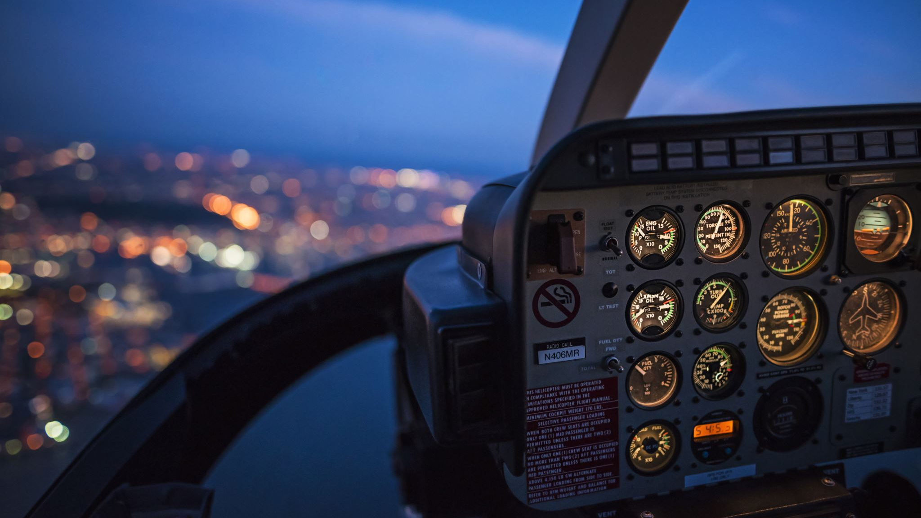
Navigation & Controllers

Slide 11
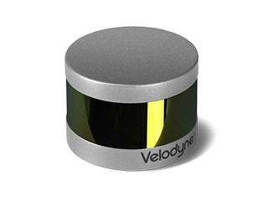
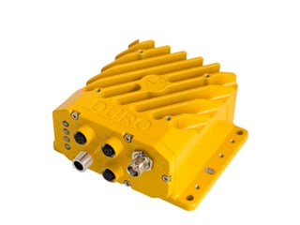
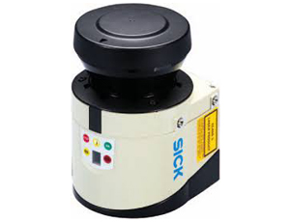
Velodyne
SwiftNav
SICK
Duro GPS
LMS-111 Lidar
VLP-16

Slide 12

Data Collection

Slide 13
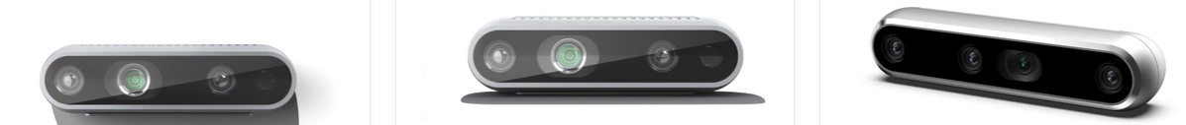
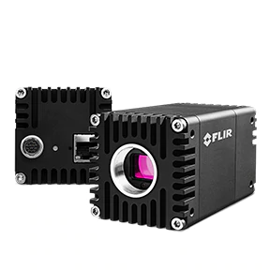
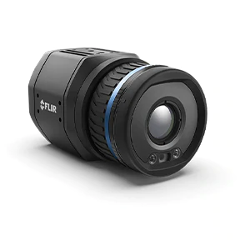
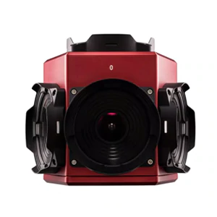
Oryx 10GigE & Blackfly S
Intel RealSense D435
FLIR A400/A700
Ladybug5+

Slide 14

Data transmission

Slide 15
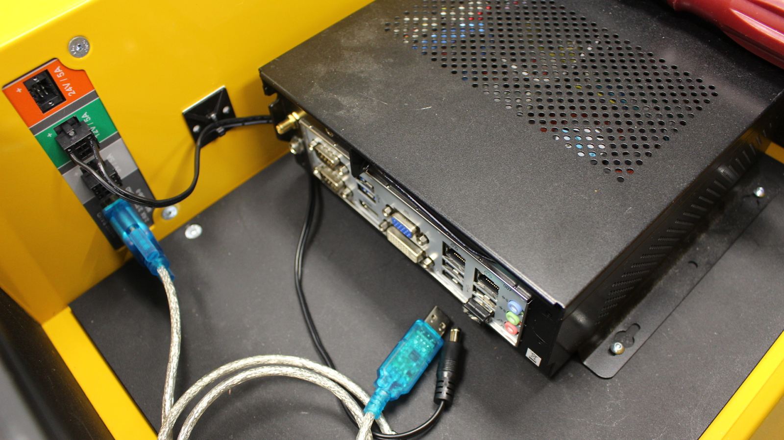
Mini-Itx Computer For WiFi communication Husky UGVs need: TP-Link Router to build the WiFi network. WiFi adapter (intel® centrino® advanced-n 6235, dual band) in the onboard pc.

Slide 16

Power management system

Slide 17
Power delivery system
1000W Peak Drive Power
400W Continuous
24V 20Ah Rechargable Battery
3hrs Typical run time, 8 hrs max run time

Slide 18
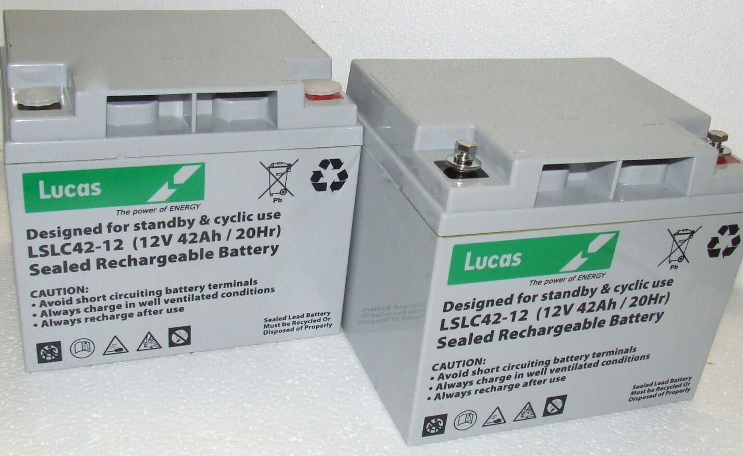
Battery

Slide 19
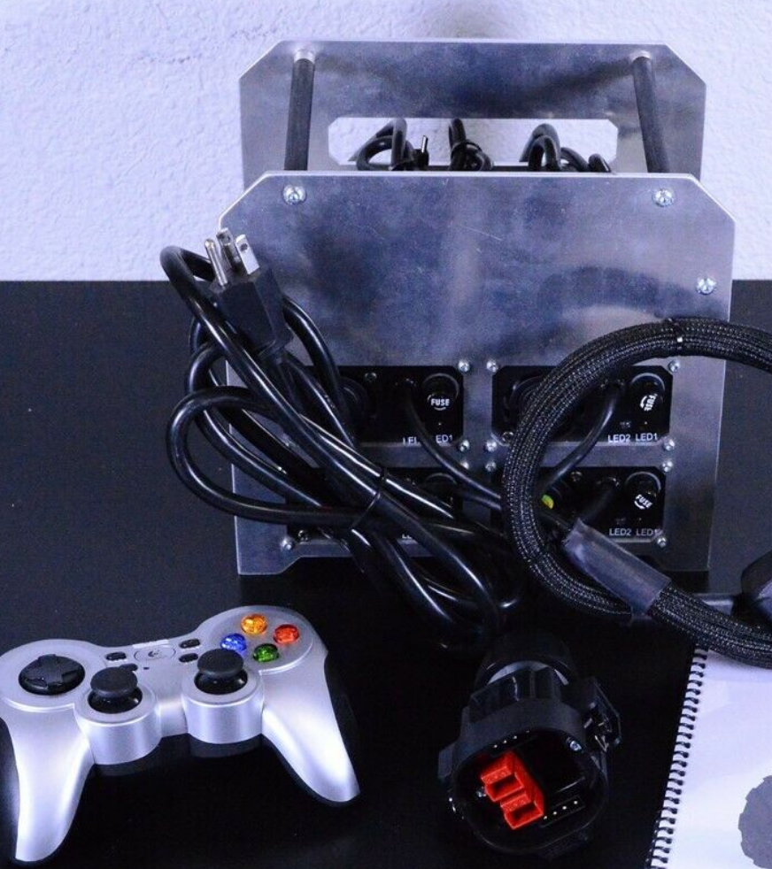
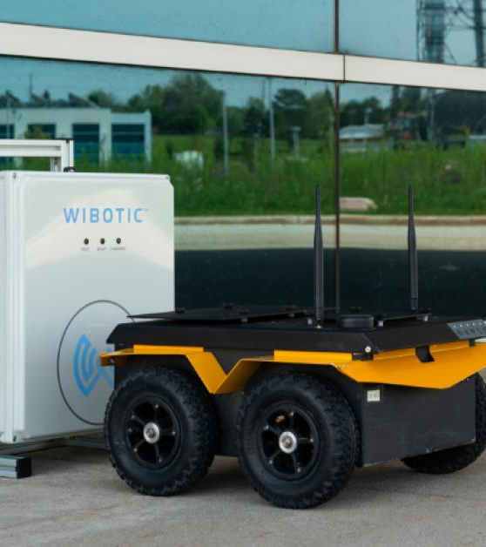
Wired
Wireless

